Slide 1
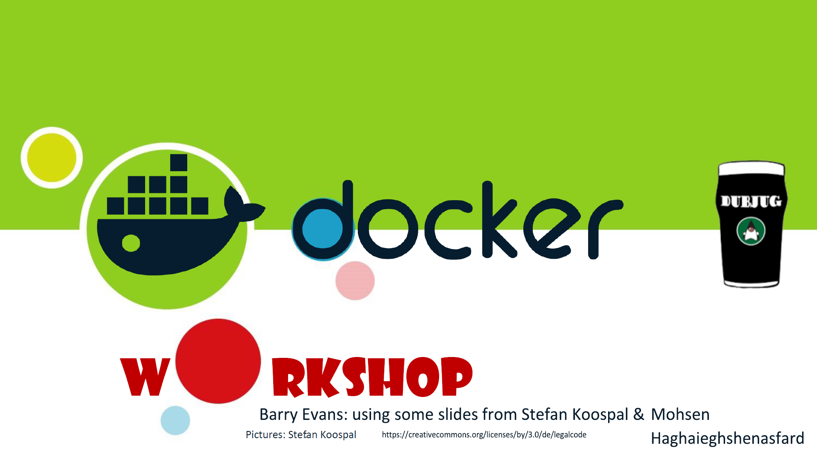
@ BelfastJUG

Slide 2
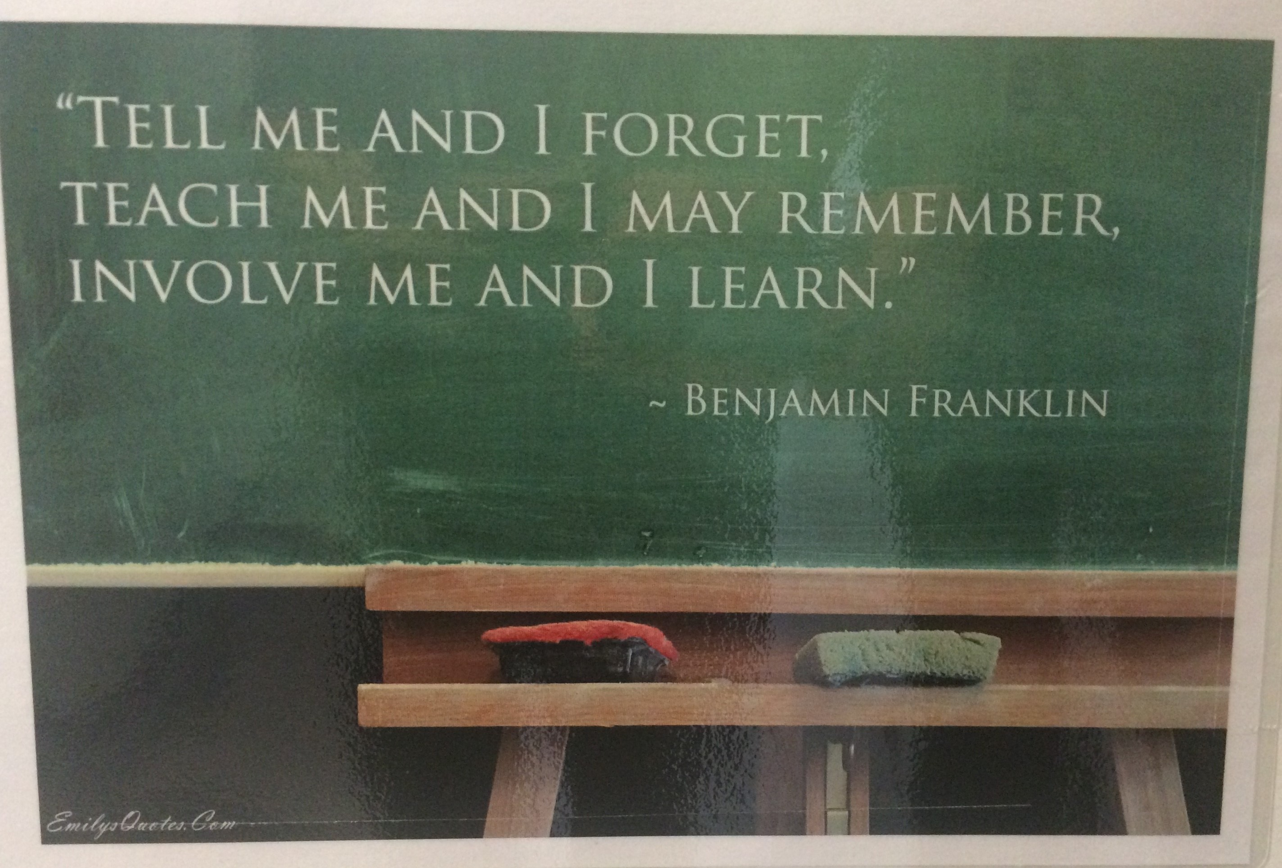
Why are we here?

Slide 3
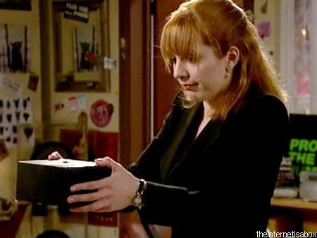
Safe Harbour statement
This is a live coding session…
Anything could happen!!!
http://www.dailyedge.ie/break-the-internet-1780874-Nov2014/

Slide 4
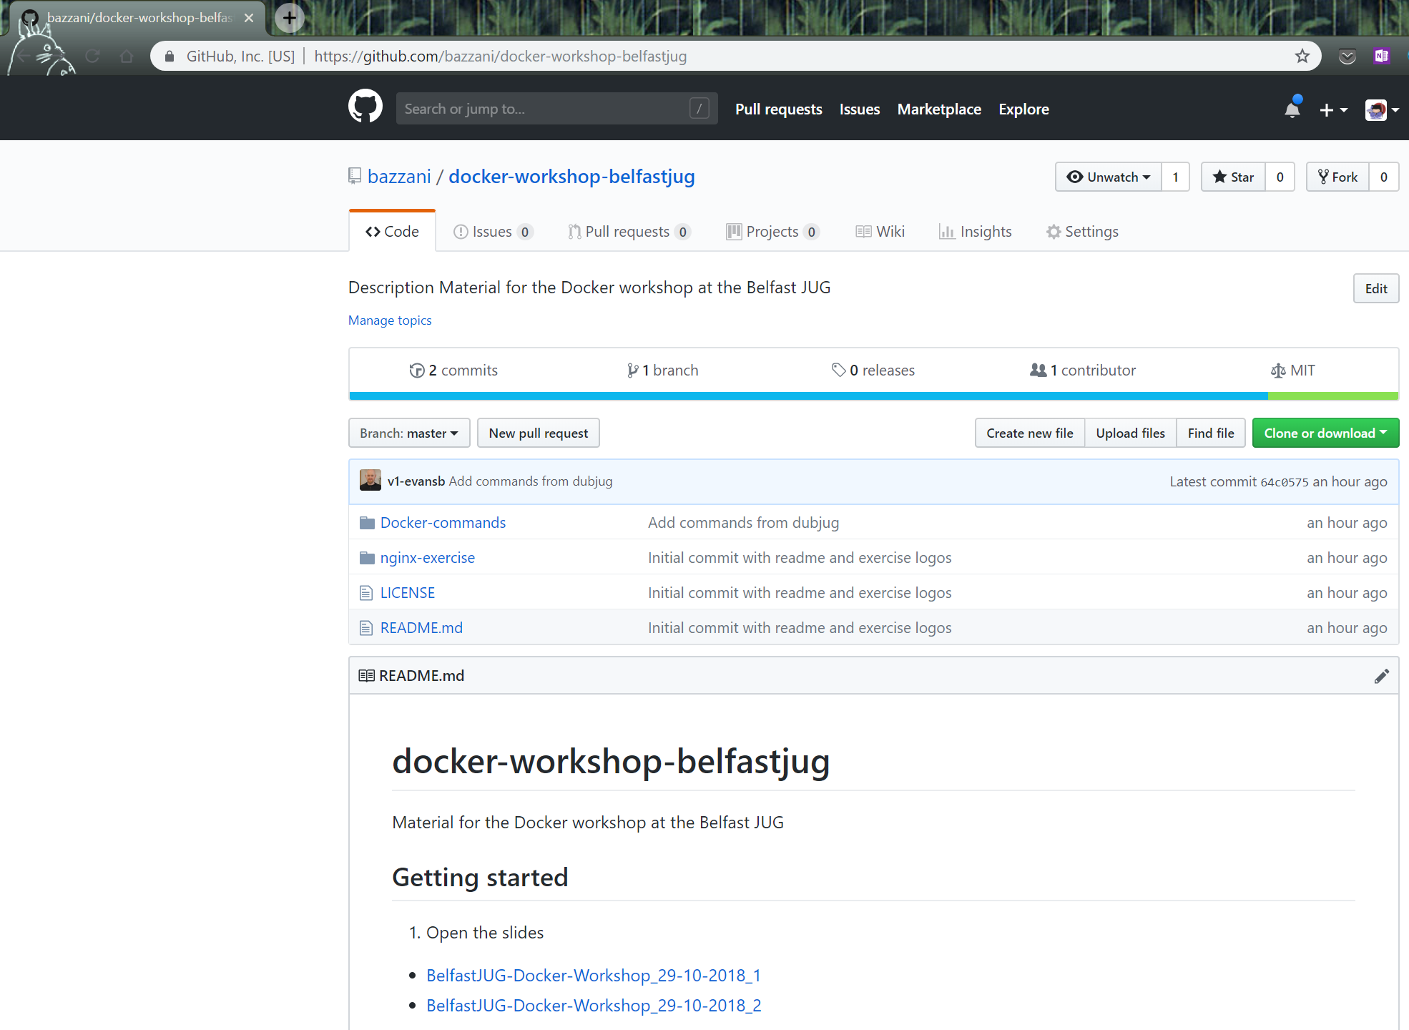
Without further ado…
https://github.com/bazzani/docker-workshop-belfastjug

Slide 5
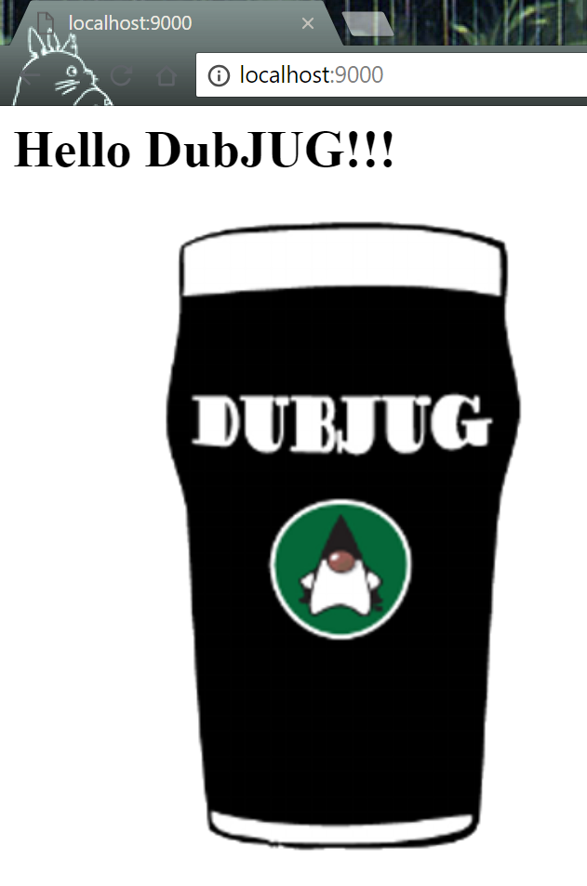
Time to show us what you learned

Slide 6

Thank you for your time

